Slide 1
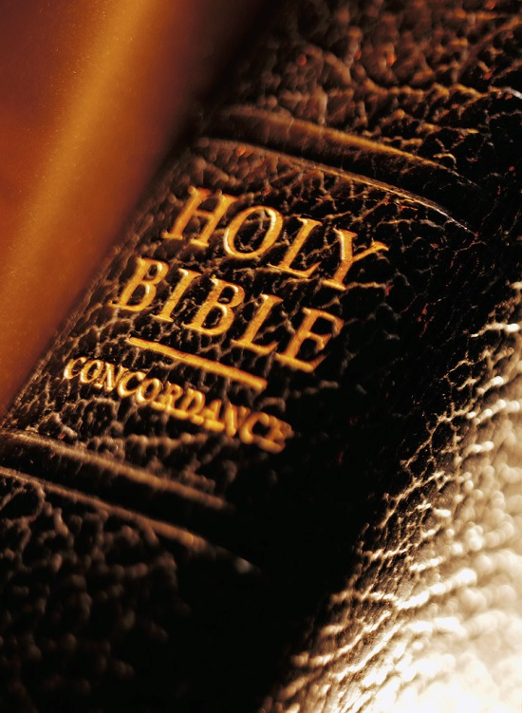
Expository
Excerpts
From Acts 2
(Acts 2:42-47)
Fervor of the Early Church
qualities of the disciples (4)
All Verses Are From The NKJV Unless Noted

Slide 2
Acts 2 Broken Down
2:1-11 – God Keeps His Promises
2:12, 13 – Man’s Slow Heart
2:14-36 – Wisdom in Answering Critics
2:37-41 – The Desired Effect and Plan
2:42-47 – The Fervor of the Early Church
The steadfast practice (2:42)
The qualities of the disciples (2:43-46)
  FEAR
  UNITY
  CHARITY
  ?

Slide 3


Slide 4

“So continuing daily with one accord in the temple, and breaking bread from house to house, they ate their food with gladness and simplicity of heart” (2:46)
In the temple for worship/prayer
(cf. 2:15; 3:1)
“House to house” for “their food”
  Not as a church, 1 Cor. 11:22, 33, 34

Slide 5
“So continuing daily with one accord in the temple, and breaking bread from house to house, they ate their food with gladness and simplicity of heart” (2:46)
GLADNESS – exuberant joy
(Lk. 1:13, 14, 44; Heb. 1:9)
SIMPLICITY OF HEART - sincerity

Slide 6
The early church was JOYFUL!
In being reconciled to God
(Acts 8:39; Rom. 5:11)
Over the conversion of the Gentiles (Acts 15:3)
In tribulation (Acts 5:41; 2 Cor. 7:4)

Slide 7
Iniquity (1 Cor. 13:6; Prov. 10:1)
ungrateful service
(Deut. 28:47, 48)
Worldliness (Jas. 4:4, 8, 9; cf. Heb. 10:34)
Anxiety (Prov. 12:25)

Slide 8
Hebrews 12:14, 15
14 PURSUE peace with all people, and holiness, without which no one will see the Lord:
15 LOOKING CAREFULLY lest anyone fall short of the grace of God; lest any root of bitterness springing up cause trouble, and by this many become defiled;
GRACE

Slide 9
Acts 2 Broken Down
2:1-11 – God Keeps His Promises
2:12, 13 – Man’s Slow Heart
2:14-36 – Wisdom in Answering Critics
2:37-41 – The Desired Effect and Plan
2:42-47 – The Fervor of the Early Church
The steadfast practice (2:42)
The qualities of the disciples (2:43-46)
The Growth (Acts 2:47)

Slide 10
J. W. McGarvey
“The last expression does not mean that they were merely in the way of salvation; but that they were saved. They were saved in the sense in which Peter had exhorted those on Pentecost to “save themselves.” The word save means to make safe; and a man is made safe from all his past sins when they are forgiven. He can be saved from them in no other way.”
New Commentary on Acts of Apostles, p. 49

Slide 11
Can The Lord Add You To His Church Today?
“Then Peter said to them, ‘Repent, and let every one of you be baptized in the name of Jesus Christ for the remission of sins; and you shall receive the gift of the Holy Spirit’” (Acts 2:38)

